Slide 1
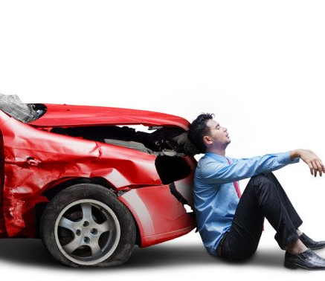
ANALYSIS OF CAR ACCIDENTS
Submitted By:
Sherin Joseph
23/Nov/2021

Slide 2
Outline
Introduction
Background
Objectives of Analysis
Methodology
Study Variables
Univariate and Bivariate Analysis
Hypothesis Testing and Findings
Conclusions and Recommendations
Appendix

Slide 3
Introduction
The project is focused on deriving meaningful insights from the car accident data so that we could figure out the major victims affected, main areas accidents occur and factors affecting it.
Valid recommendations can be provided to the Barcelona state for improvements in traffic system and reducing accidents.

Slide 4
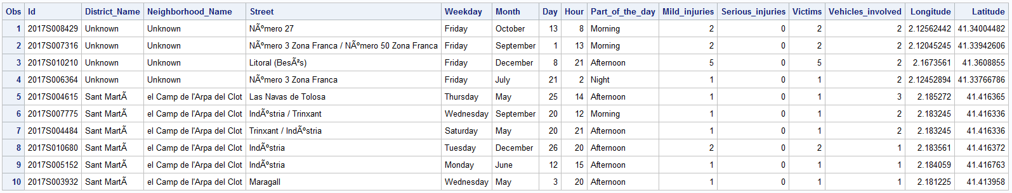
Background
The dataset contains car accident details in the State of Barcelona in the year 2017.
There are 10,339 observations and 15 columns.
Key attributes are District, Neighbourhood, Weekday, Month, Hour of Day, Injuries and Vehicles Involved.

Slide 5
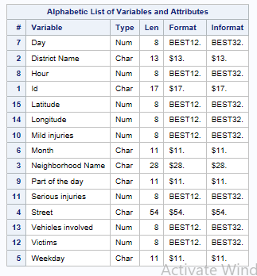
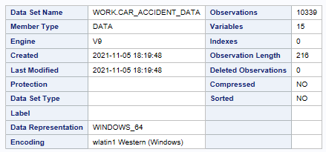
Data Profiling
Target Y Variable: Victims

Slide 6

Objectives
Which district and neighborhood accounted for the maximum number of accident victims in 2017.
Are victims affected different across different districts and why so.
What time of the day has the maximum victims reported and are they significantly different.
Are victims affected significantly different on weekdays compared to weekends.
Which month of the year has highest and least victims and how are they different from other months.

Slide 7
Methodology
Data Definition
District_Name – Name of District
Neighborhood_Name – Name of Neighborhood
Street – Name of Street
Weekday – Day of the week
Month – Month of the year
Day – Day of the month
Hour – Hour of the day
Part_of_the_day – Time of the day
Mild_Injuries – Number of mild injuries
Serious_Injuries – Number of serious injuries
Victims – Number of victims affected
Vehicles_involved – Number of vehicles involved
Longitude – Longitude in map
Latitude – Latitude in map
Inclusions
The major parameters such as District, Neighbourhood, Weekday, Month, Hour of Day, mild Injuries, serious injuries and Vehicles are included for the Analysis.
There are no missing values in the data and hence all the data points are considered for analysis.
Exclusions
The variable Street is excluded as it does not have any significant role.
The variable Hour is converted to the time period of the day and hence Part_of_the_day is excluded.
Since District and Neighborhood give geographic information, latitude and longitude and excluded from modelling.
The “Unknown” values in District and Neighborhood fields are replaced by the mode of respective columns.
Software
Base SAS 9.4
Statistical Methods
Chi-square Test
Multinomial Logistic Regression

Slide 8
Study Variable
Independent Variables
Target Variable
District_Name
Neighborhood_Name
Mild_Injuries
Victims
Serious_Injuries
Vehicles_involved
Weekday
Month
Hour

Slide 9
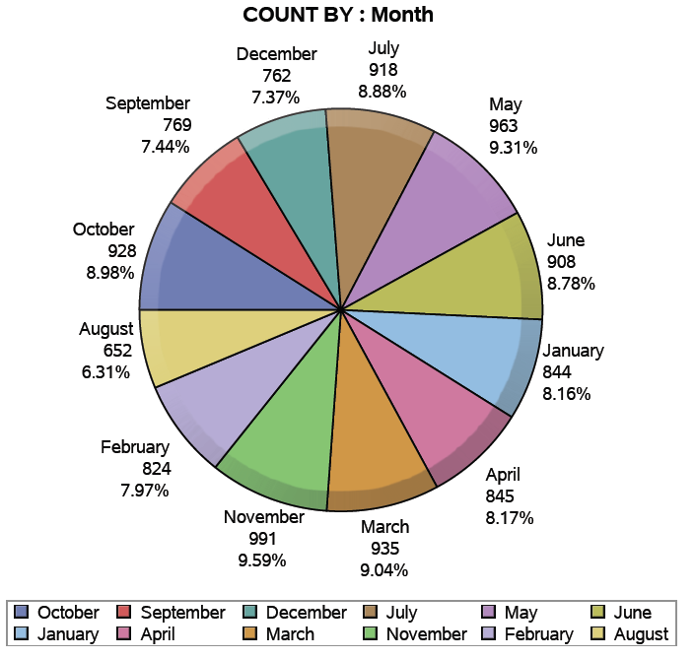
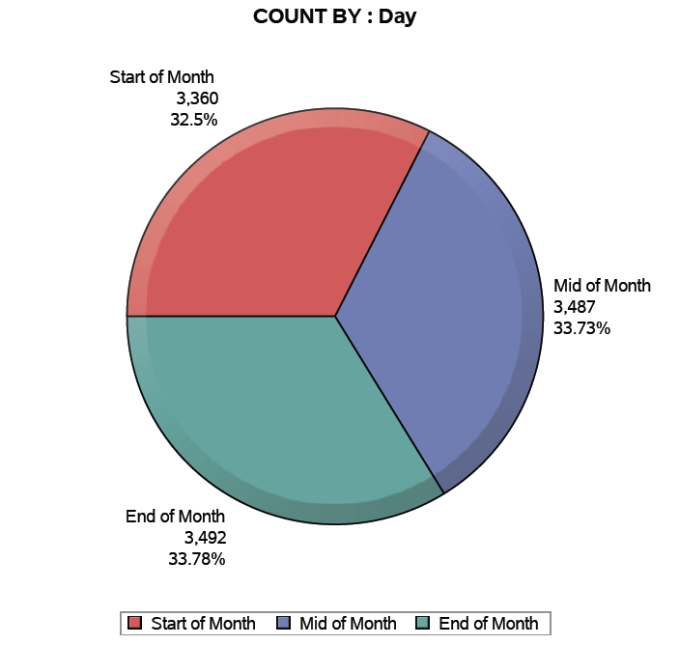
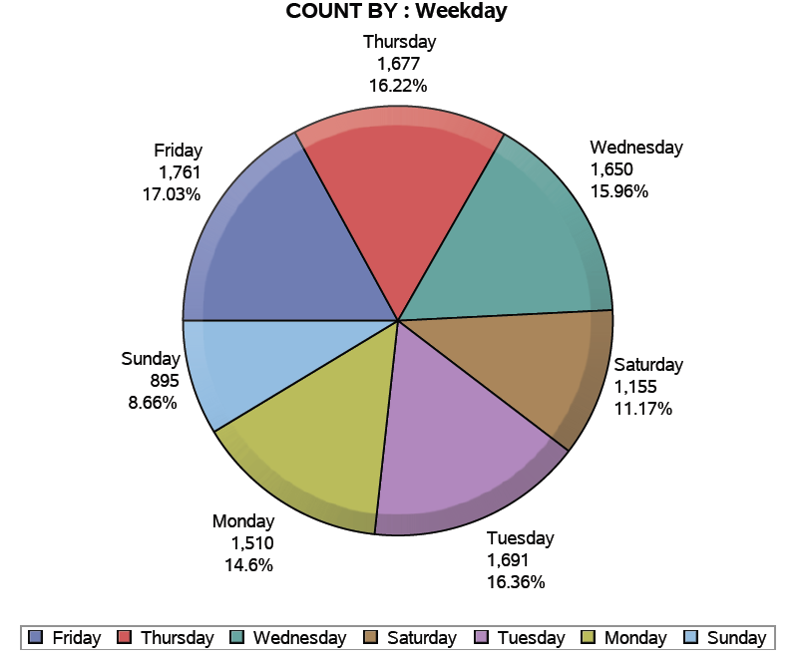
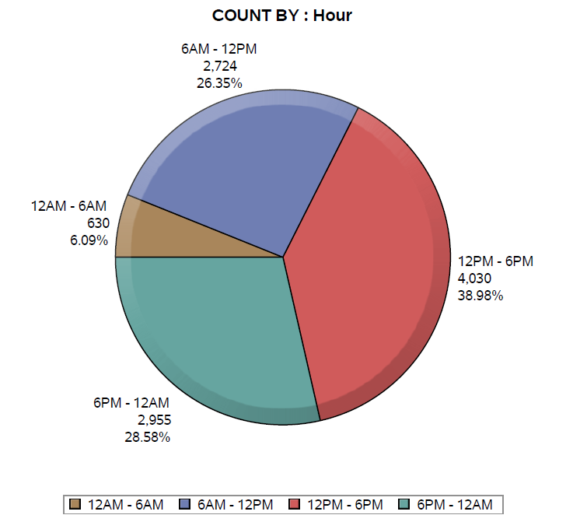
Univariate Analysis
9
The months are almost equally distributed. However November is in the first place with 9.59% and August falls in the last place with 6.31%.
All the parts of the months (Start, Mid and End) are equally distributed as seen in the pie chart.
Friday stays top of the list with 17% of accidents and Sunday is the least with 8.66%.
Nearly 40% of the accidents occur during the afternoon from 12PM – 6PM

Slide 10
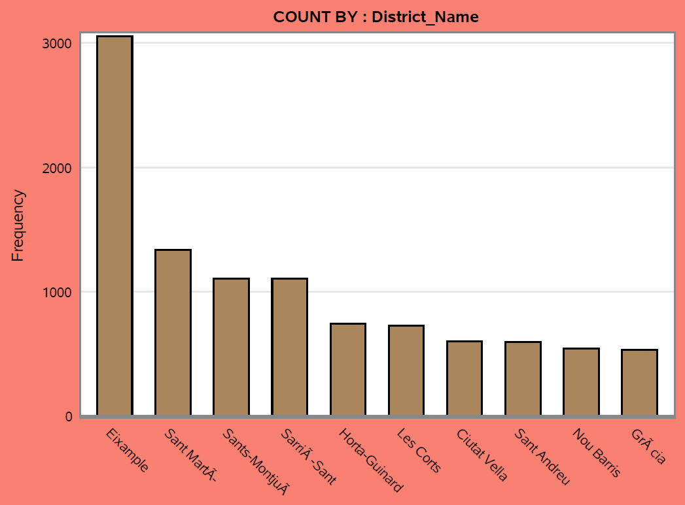
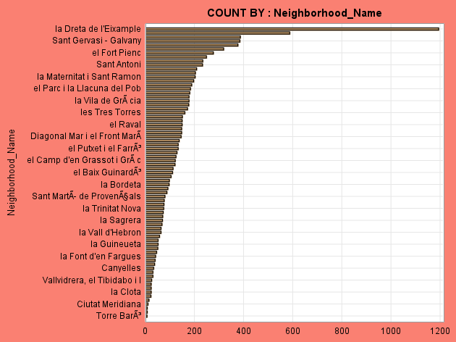
Maximum accidents occur in the Eixample district and the least accidents are in the Gracia district.
Other districts which have higher accident rates are Santa MartA, Sants-MontjuA and SarriA-Sant.
The neighborhood “la Dreta de l’Eixample” has the highest reported accidents and “Torre BarA” has the least count.

Slide 11
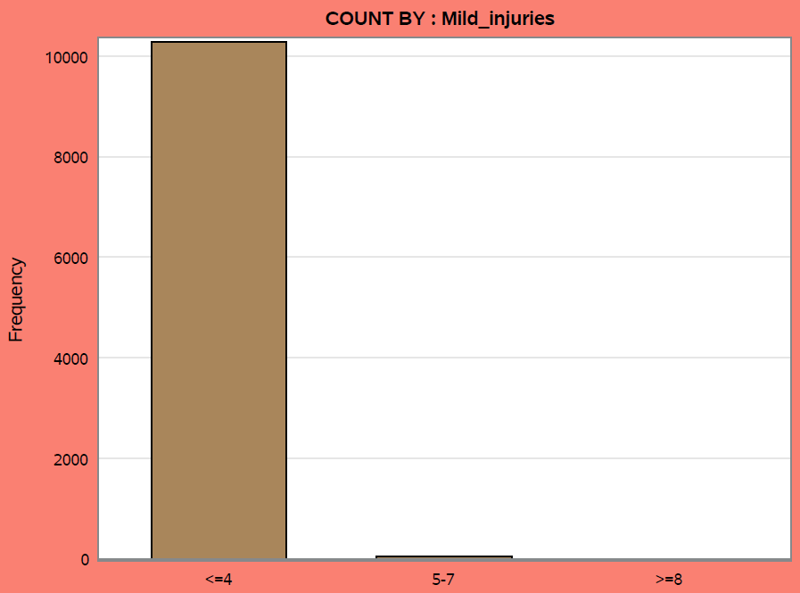
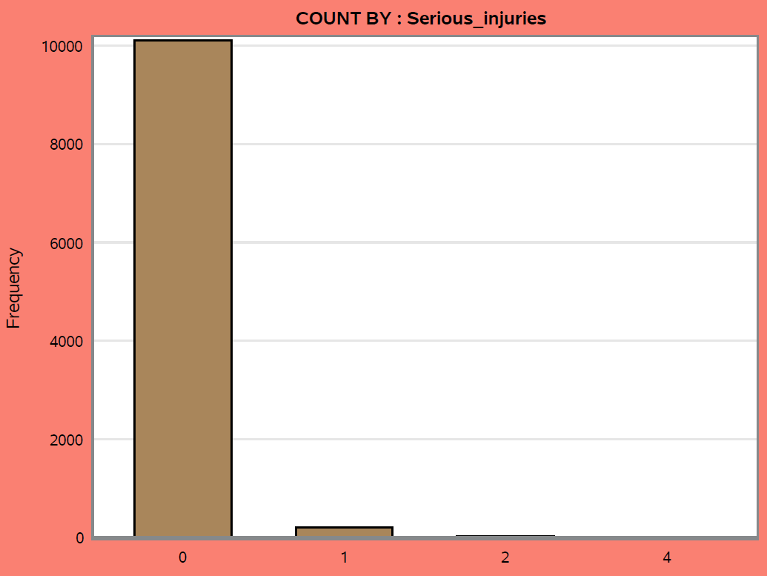
Distribution of serious injuries reveals that accidents that made higher serious injuries were way less than those with smaller counts.
From the accident history, accidents involving mild injuries category <=4 are more compared to other categories

Slide 12
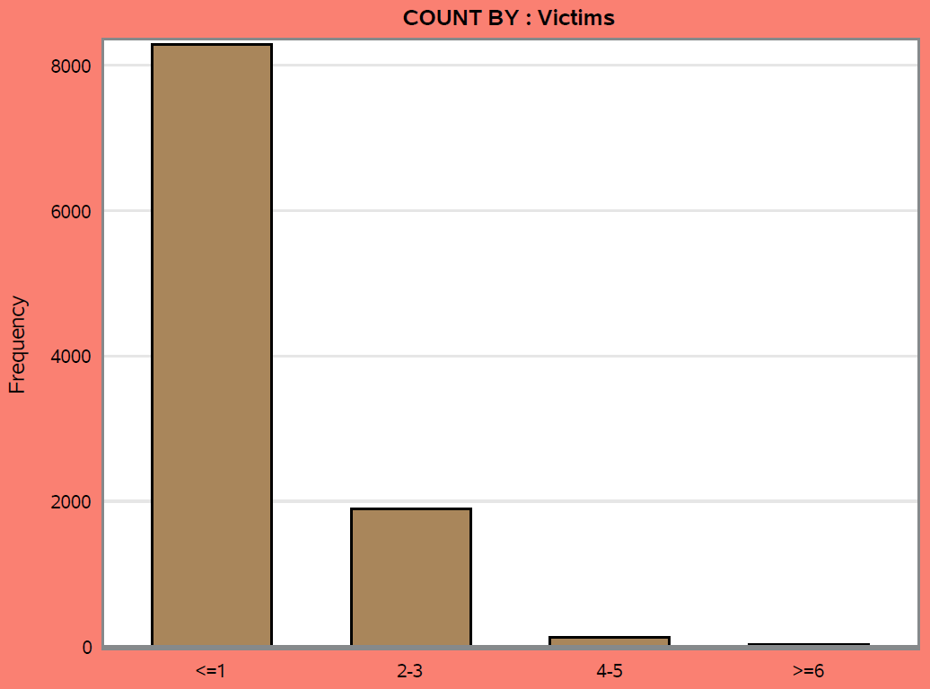
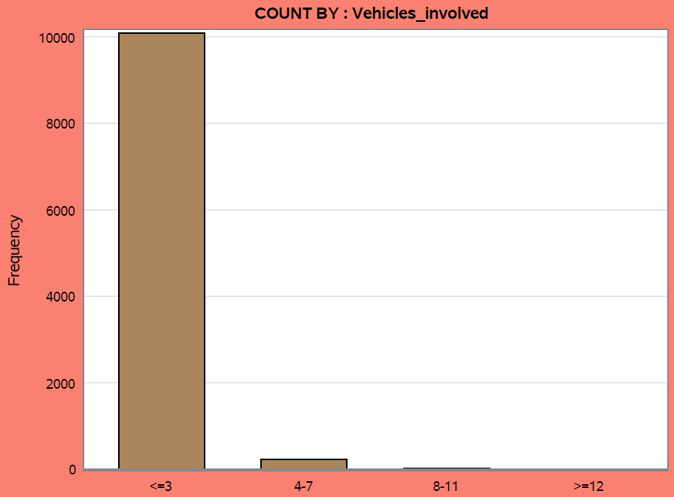
Victims <=1 are way higher than the higher count categories.
Accidents involving vehicles <=3 are more compared to other categories.

Slide 13

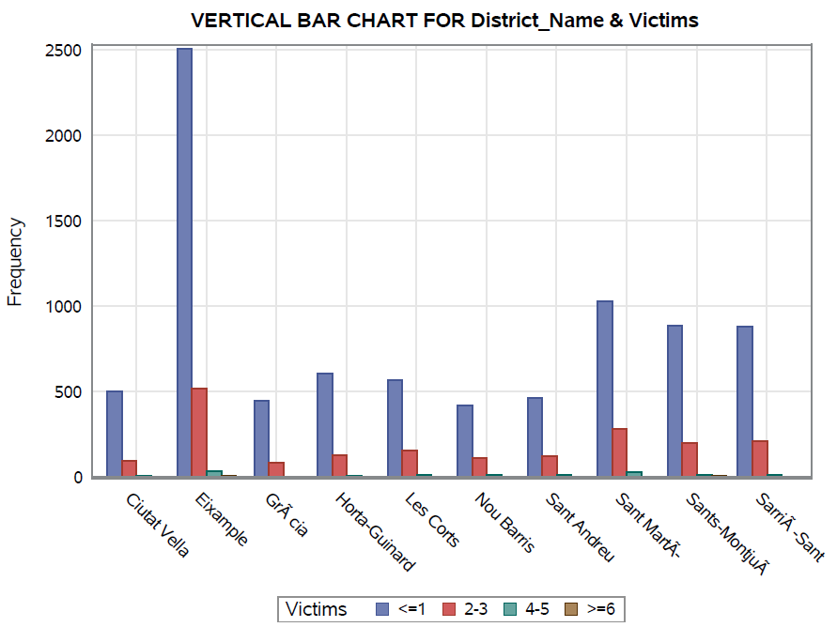
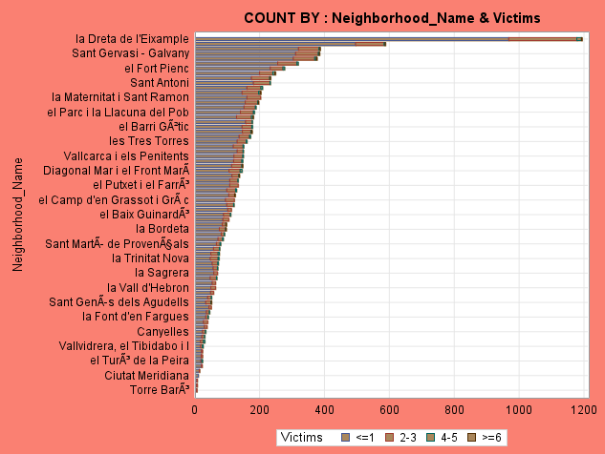
Bivariate Analysis
Maximum victims were reported in the Eixample district and the least accidents are in the Gracia district.
The neighborhood “la Dreta de l’Eixample” has the highest number of victims and “Torre BarA” has the least count.

Slide 14
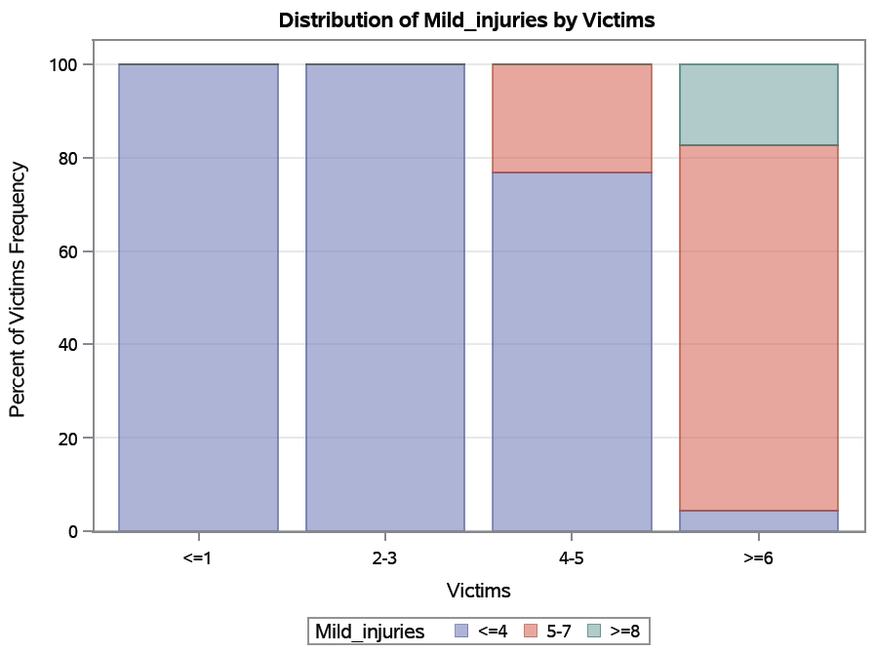
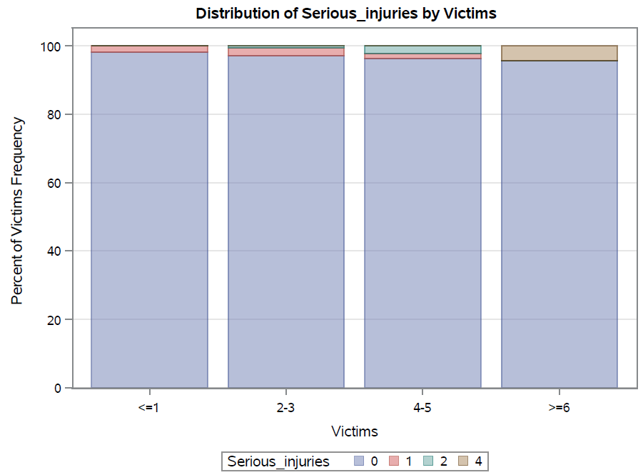
14
The stacked bar chat shows that as when the victims affected are more, the serious injuries are more.
In the group if victims “>=6” above 75% of mild injuries belong to group “5-7”. As victims affected increase, the mild injuries level also increase.

Slide 15
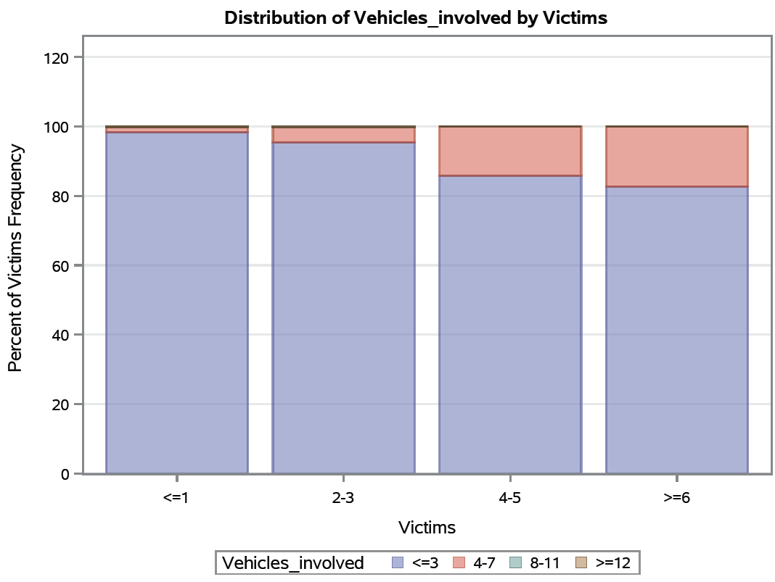
The stacked bar char reveals that the vehicles involved in accident is significantly different across the victim groups.
As the vehicles involved increases, the victims affected also increases.

Slide 16
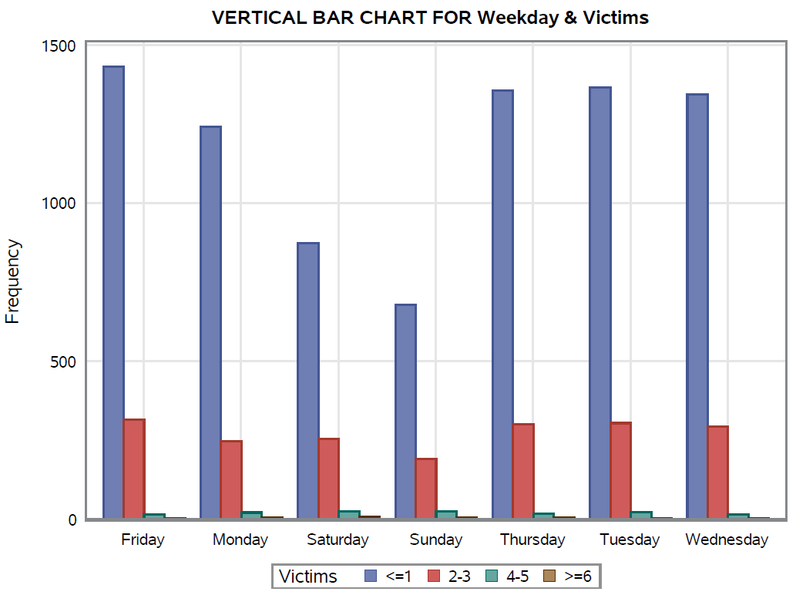
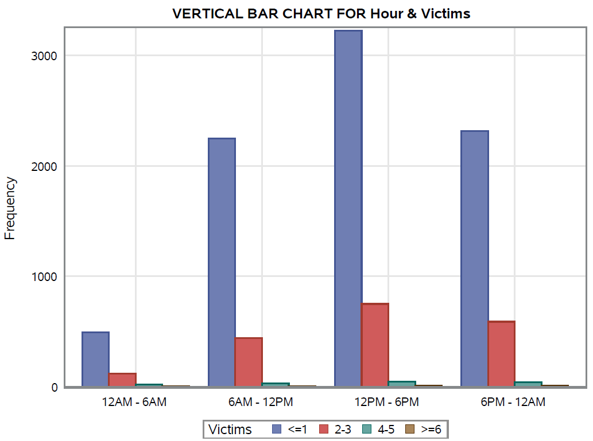
Victims are more during the weekdays compared to weekends where Sunday reporting the lowest count.
Victims are more reported in the accidents that occur during the afternoon from 12PM – 6PM, followed by 6PM-12AM, 6AM-12PM and finally 12AM-6AM.

Slide 17
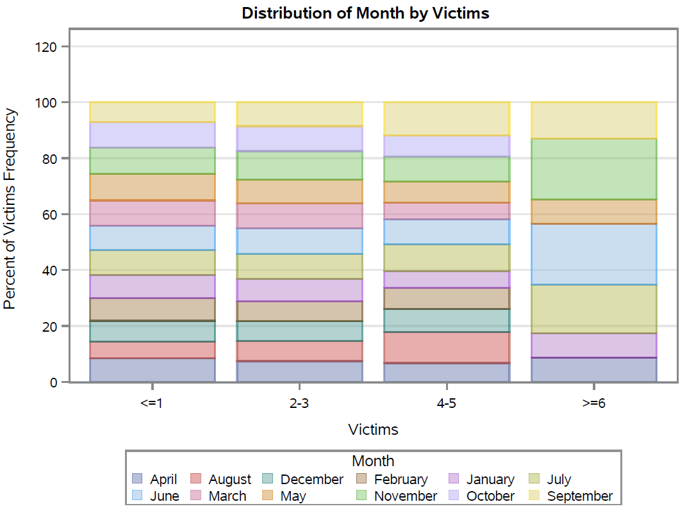
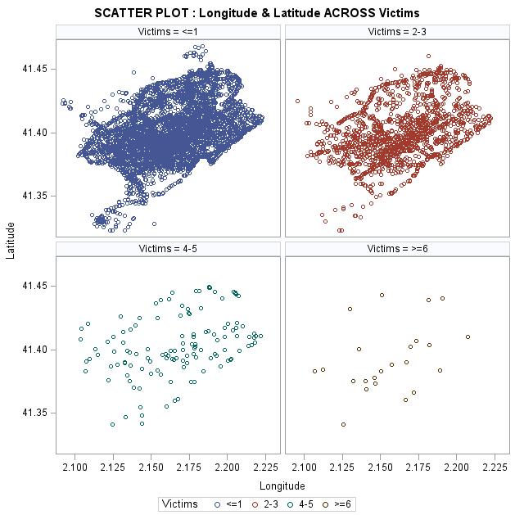
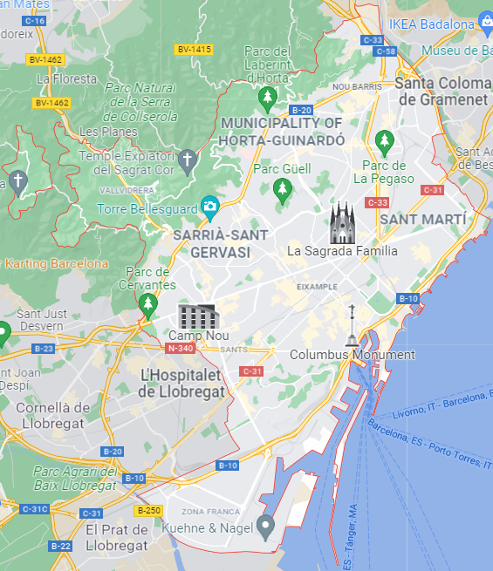
17
In the victim groups <=1, 2-3 and 4-5, there is no much significant difference across the different months.
However, Months “August”, ”December”, “February”, “March” and “October” do not have victims over 6 in a single accident.
The geological comparison allows to identify the hot spot areas.

Slide 18
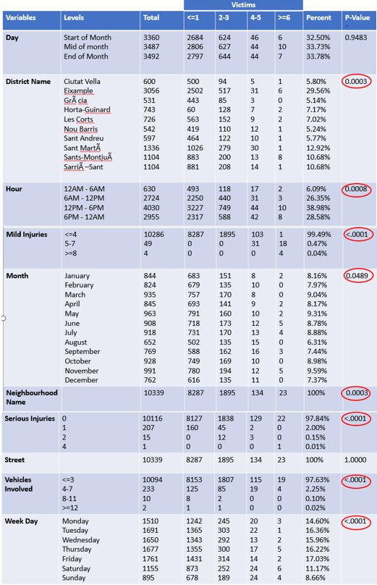

Chi-Square Test Summary
18
RELEVANT VARIABLES
District Name
Hour
Mild Injuries
Month
Neighborhood Name
Serious Injuries
Vehicles Involved
Week Day

Slide 19
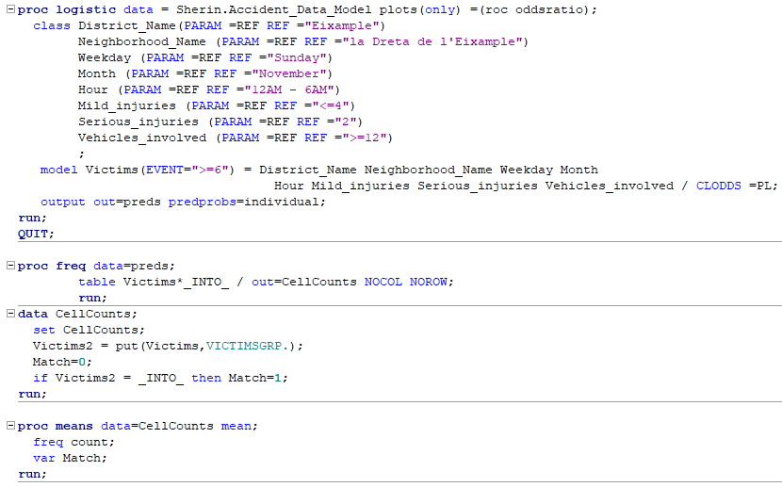
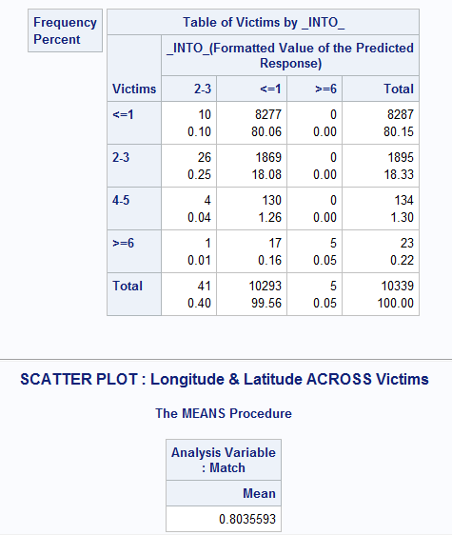
Logistic Regression
ACCURACY

Slide 20
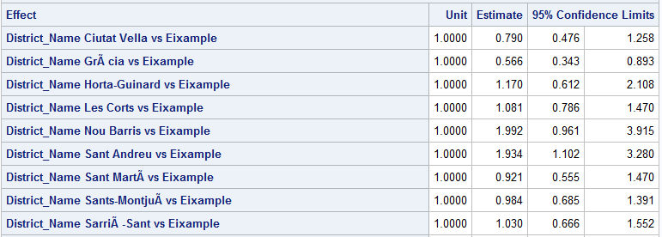
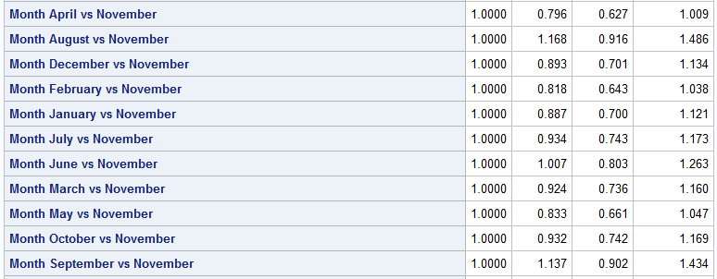
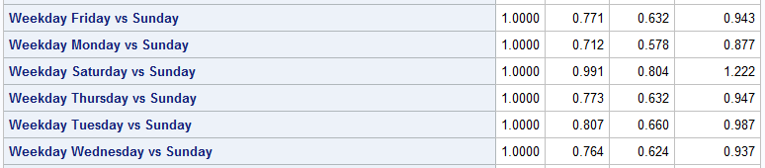
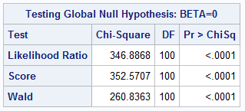



Slide 21
Conclusions
The odd of District “Eixample” and neighborhood “la Dreta de l’Eixample” is significantly different from others.
The odd of time period 12PM-6PM to have victims >=6 is 1.047 times the odd of period 12AM-6AM.
The odd of time period 6PM-12AM to have victims >=6 is 1.107 times the odd of period 12AM-6AM.
Even though the accidents are lower on Sundays, the odd of Sunday to have victims >=6 is greater than the odd of all other days.
The month of November have reported maximum number of accidents and victims are significantly different from others.
When the reported victims are >=6, the odd of vehicles group 4-7 is higher compared to the rest of the groups.

Slide 22

Recommendations
There should be more traffic signals and speed breakers installed in the “Eixample” district and neighborhood “la Dreta de l’Eixample” because of their increased accident rates.
There should be advanced education policies implemented to the drivers in the high accident reported areas so that the awareness will reduce the accidents in the future.
The speed limit during Afternoon time should be reduced to less than 50km/hr. because of more vehicles on road and more accidents happening during that time.
More Traffic police should be deployed during the weekdays compared to weekends, especially afternoon time when school/college disperses and end of office hours.
On Sundays, more ambulance and medical crew should be deployed in hospitals because in case of accidents, the chances of casualties over 6 are higher.

Slide 23
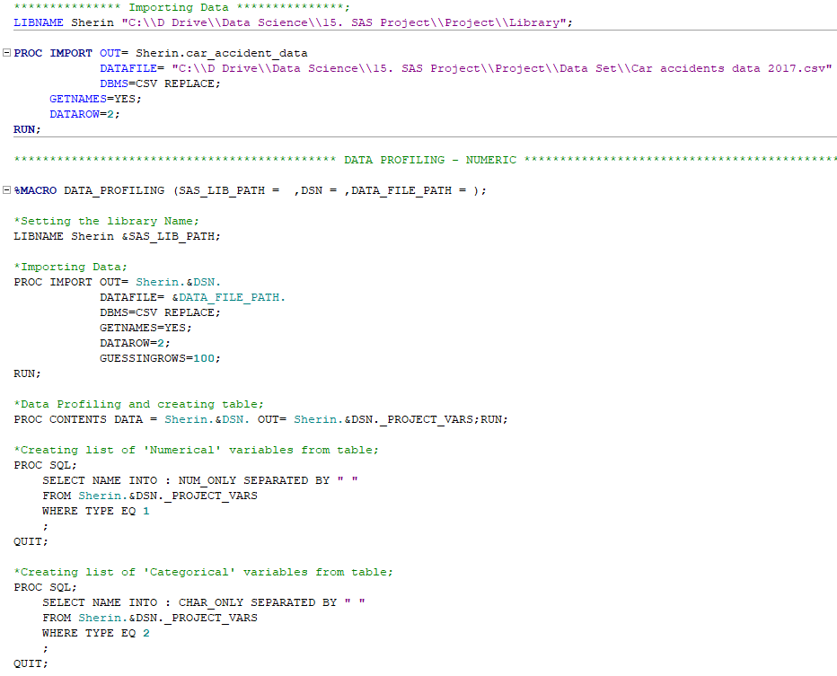
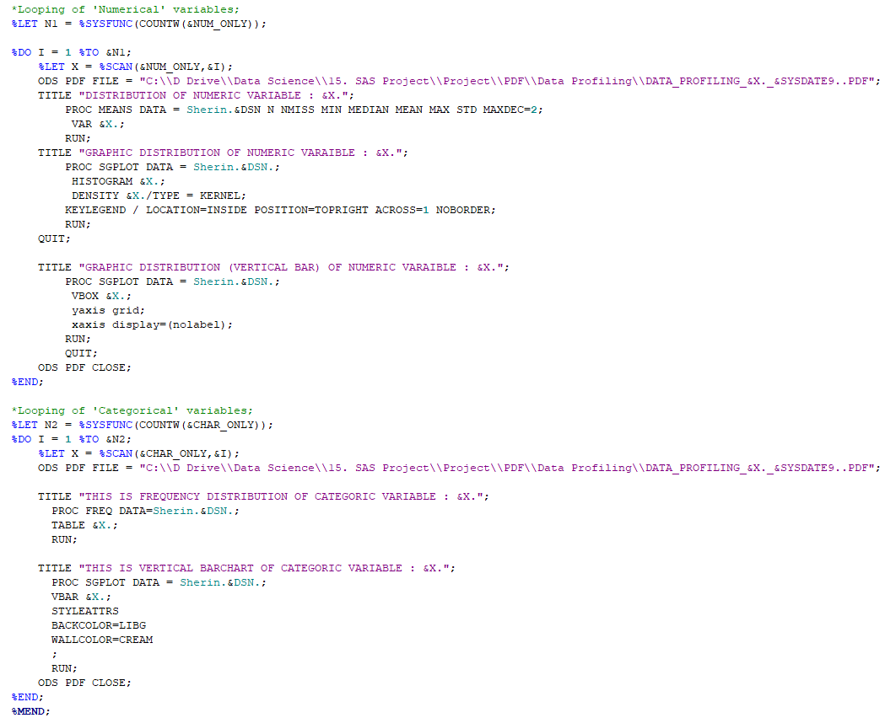
Appendix
SAS CODE

Slide 24
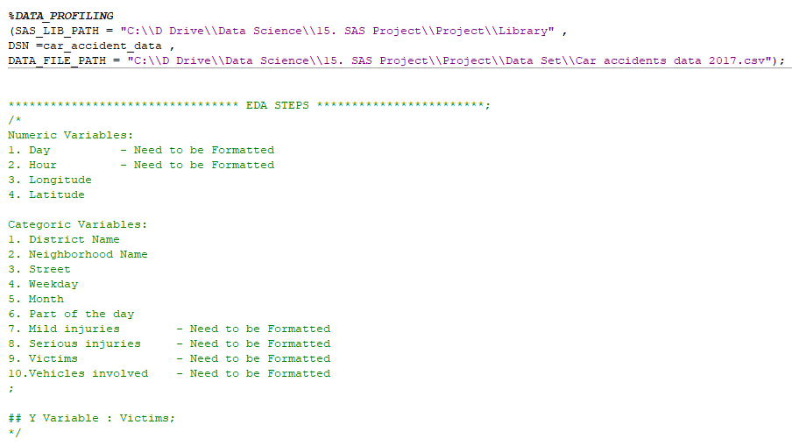
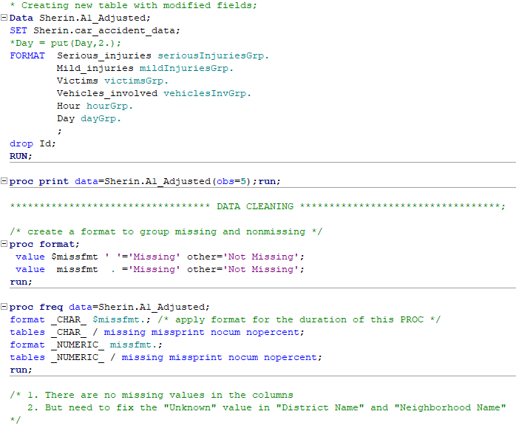
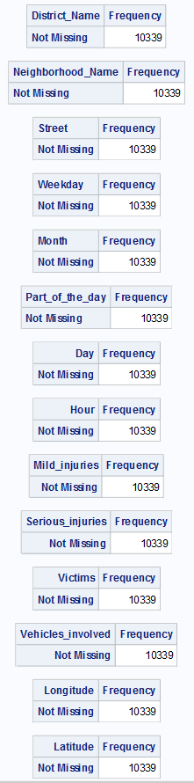
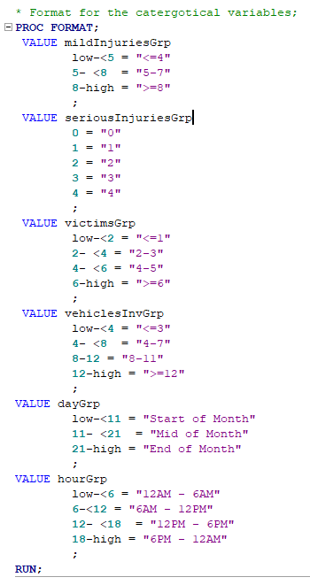
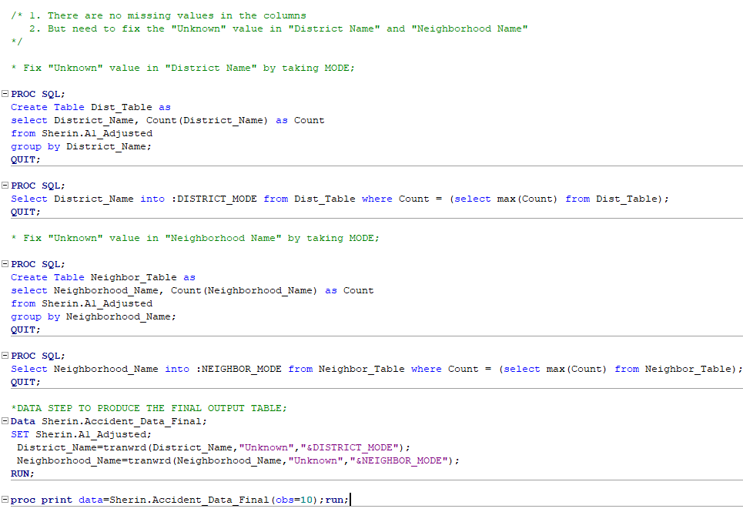

Slide 25
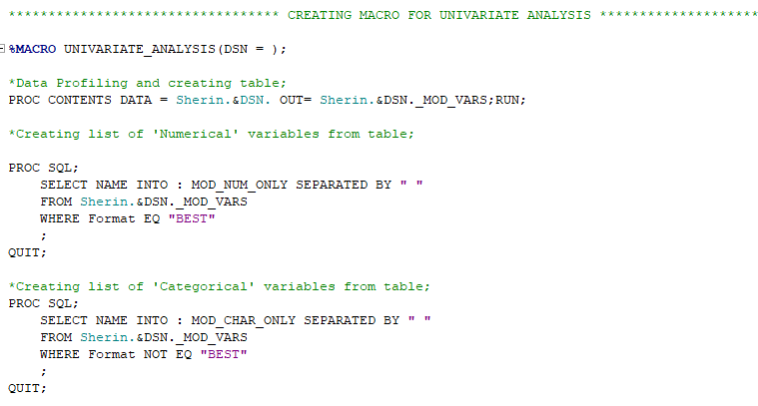
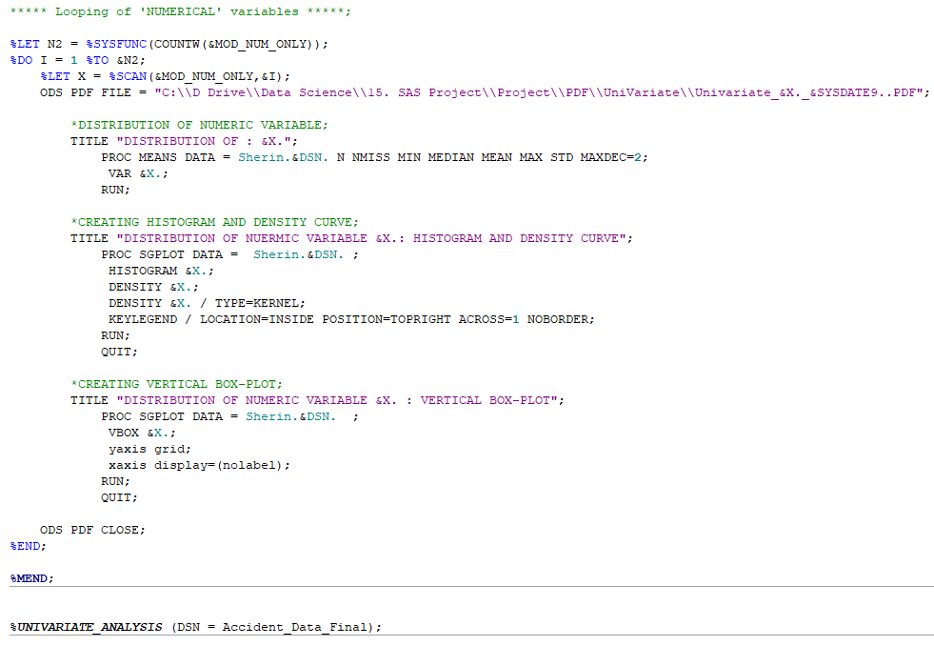
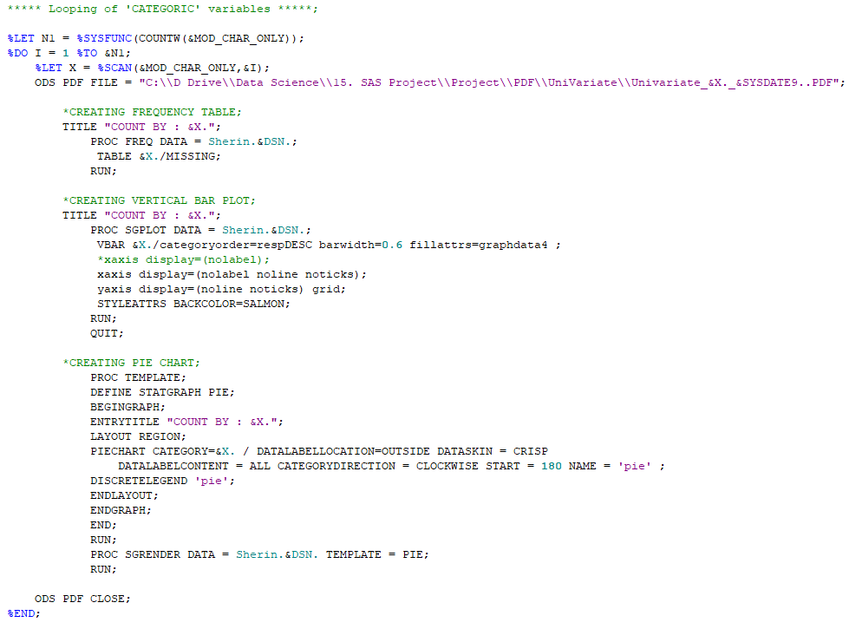
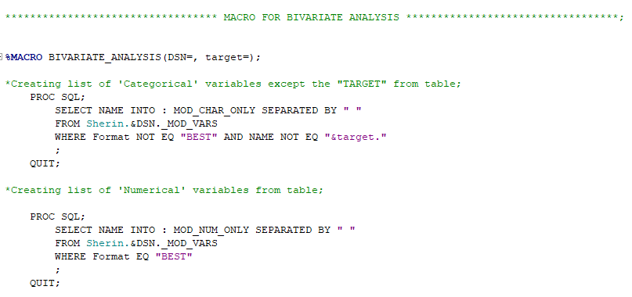

Slide 26
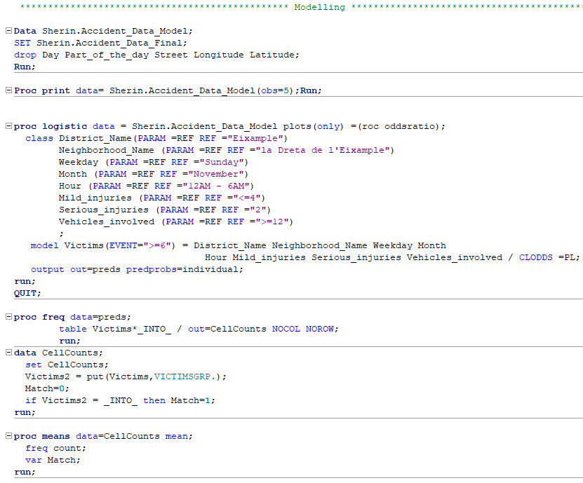
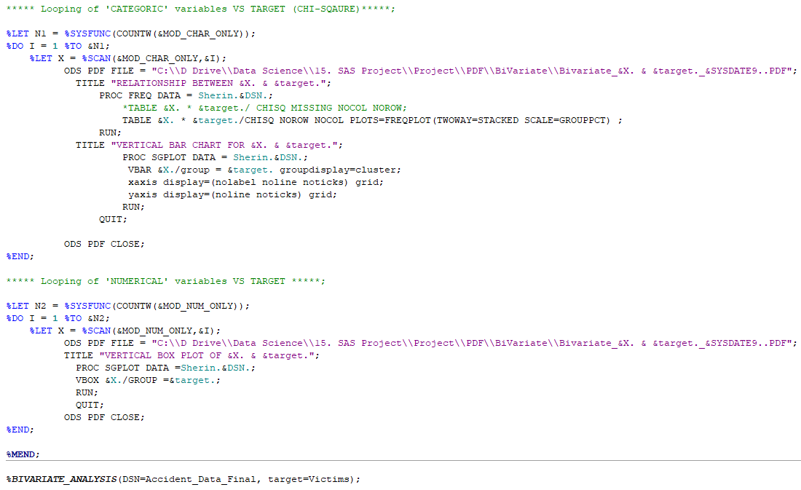
THANK YOU

